Slide 1

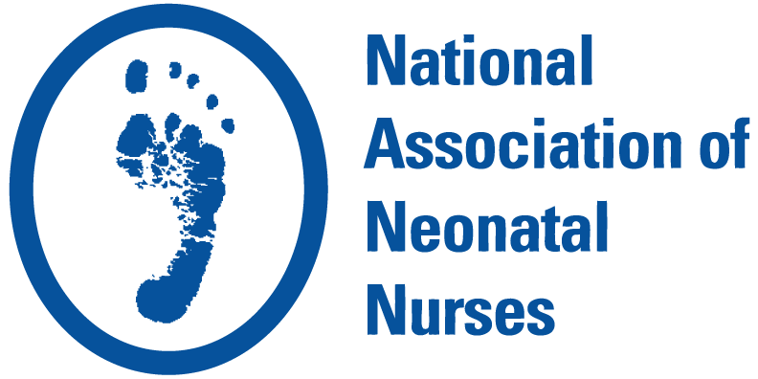
Stronger Together: Why Neonatal Nurses Choose NANN
Discover how NANN membership strengthens neonatal nurses and the units they serve
Notes:
Hi everyone, I wanted to take a little bit of time today to share information about NANN, the professional association for neonatal nursing, and why it can be useful, especially for those newer to neonatal nursing. If you’ve ever wondered whether joining a professional association is worth it, this should help answer that.

Slide 2
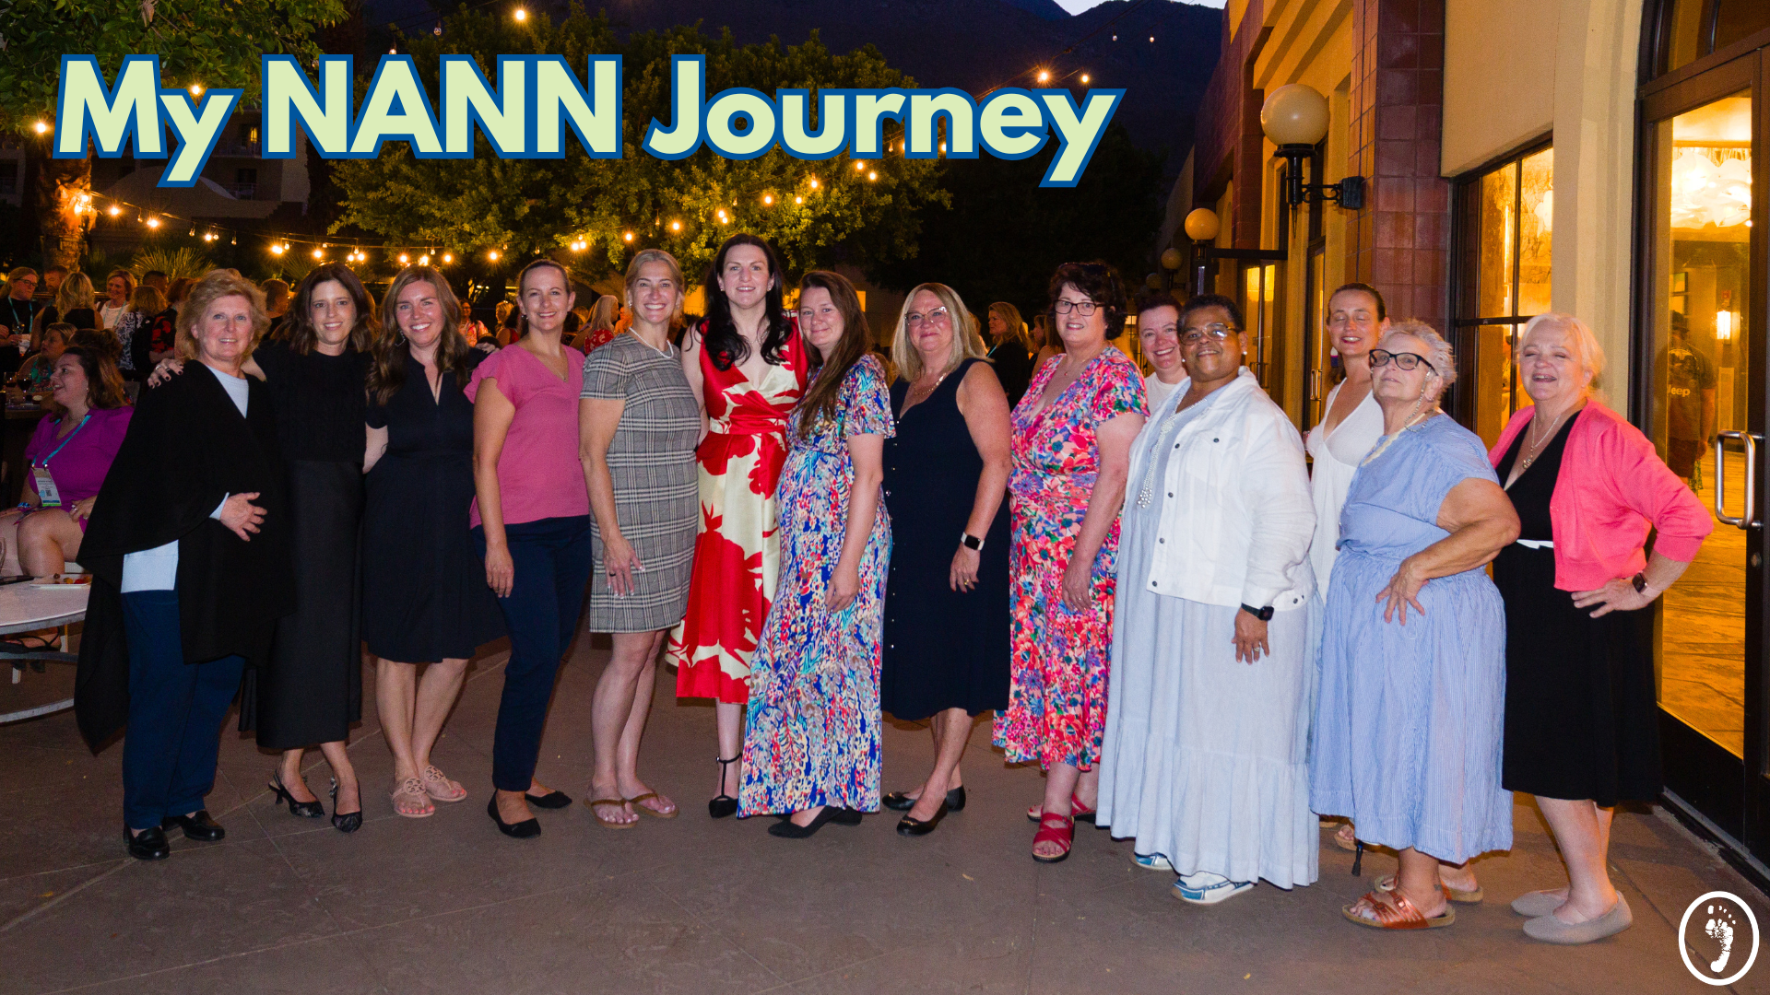

MY NANN JOURNEY
Notes:
Use this slide to briefly share your own NANN experience. You might consider touching on:
How you came to NANN (early career, later on, through a colleague, a chapter, an event, etc.)
What made you decide to get involved at the time
What being part of NANN has meant for you
This could be education, community, leadership, advocacy, support, professional growth, etc.
How involvement has helped you personally and/or professionally
Why you’ve stayed connected

Slide 3

NANN’S STRATEGIC PILLARS
Education, Professional Development & Leadership
Research, EBP & QI
Advocacy
Diversity, Equity & Inclusion
Notes:
NANN focuses its work around a few core areas that line up closely with everyday NICU practice. These include education and professional development, evidence‑based practice and quality improvement, advocacy, and diversity, equity, and inclusion. Together, these areas support both bedside care and long‑term professional growth.

Slide 4



Education, Professional Development & Leadership
NANN will provide education, leadership, and professional development support across the neonatal nursing career continuum to ensure the future growth and sustainability of the profession and association:
Ongoing comprehensive review of NANN educational offerings, updated product development process and educational dashboard
In-person, best-in-class conference, including VON Case of the Year
Continued on-demand conference offerings
Launch of the RNC-NIC Power Pack
Launch of NANN Escape Room conference experiences and products
Neo-Care Cards, 2nd edition launch April 2025
Educational collaborations with AAENP and INC with related product launches
Notes:
Education is one of the most practical reasons nurses get involved. NANN offers conferences, on‑demand learning, certification prep resources, and tools designed specifically for neonatal care. For nurses early in their careers, this can be a way to build confidence and knowledge without having to sort through endless information on your own.

Slide 5
NANN MEMBERSHIP MAKES A DIFFERENCE IN EVERY NICU!
  Patient benefits
    Care provided by nurses dedicated to professional development
    Access to nurses who belong to the standard-bearing organization
    Receive free family education in and after NICU stay
  Nurse benefits
    Enhanced professional credibility
    Leadership and volunteer opportunities
    Connection to diverse group of peers
    Free and discounted professional development and clinical education
  Employer benefits
    Supports achieving/renewing Magnet status
    Accredited training for staff at discounted price
    Improved quality of care and outcomes
Notes:
Professional association involvement has benefits on multiple levels. Patients and families benefit when nurses stay engaged in learning and best practices. Nurses benefit through skill development, credibility, and connection with peers. Units benefit when staff are supported in professional development, quality initiatives, and ongoing education. When more nurses are involved, those benefits multiply.

Slide 6
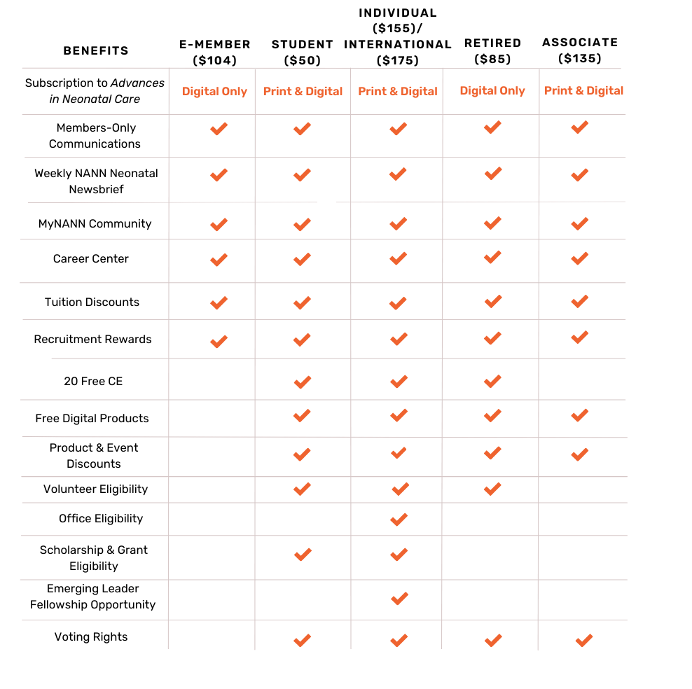
MEMBERSHIP OPTIONS FOR EVERYONE!
E-Member
Student
Individual/International
Retired
Associate
Notes:
There are different membership options depending on where you are in your career and what you’re looking for. There are full memberships, student options, digital‑only memberships, and even options for non‑nurse professionals who work in neonatal care. The idea is to make participation flexible and accessible rather than one‑size‑fits‑all.

Slide 7
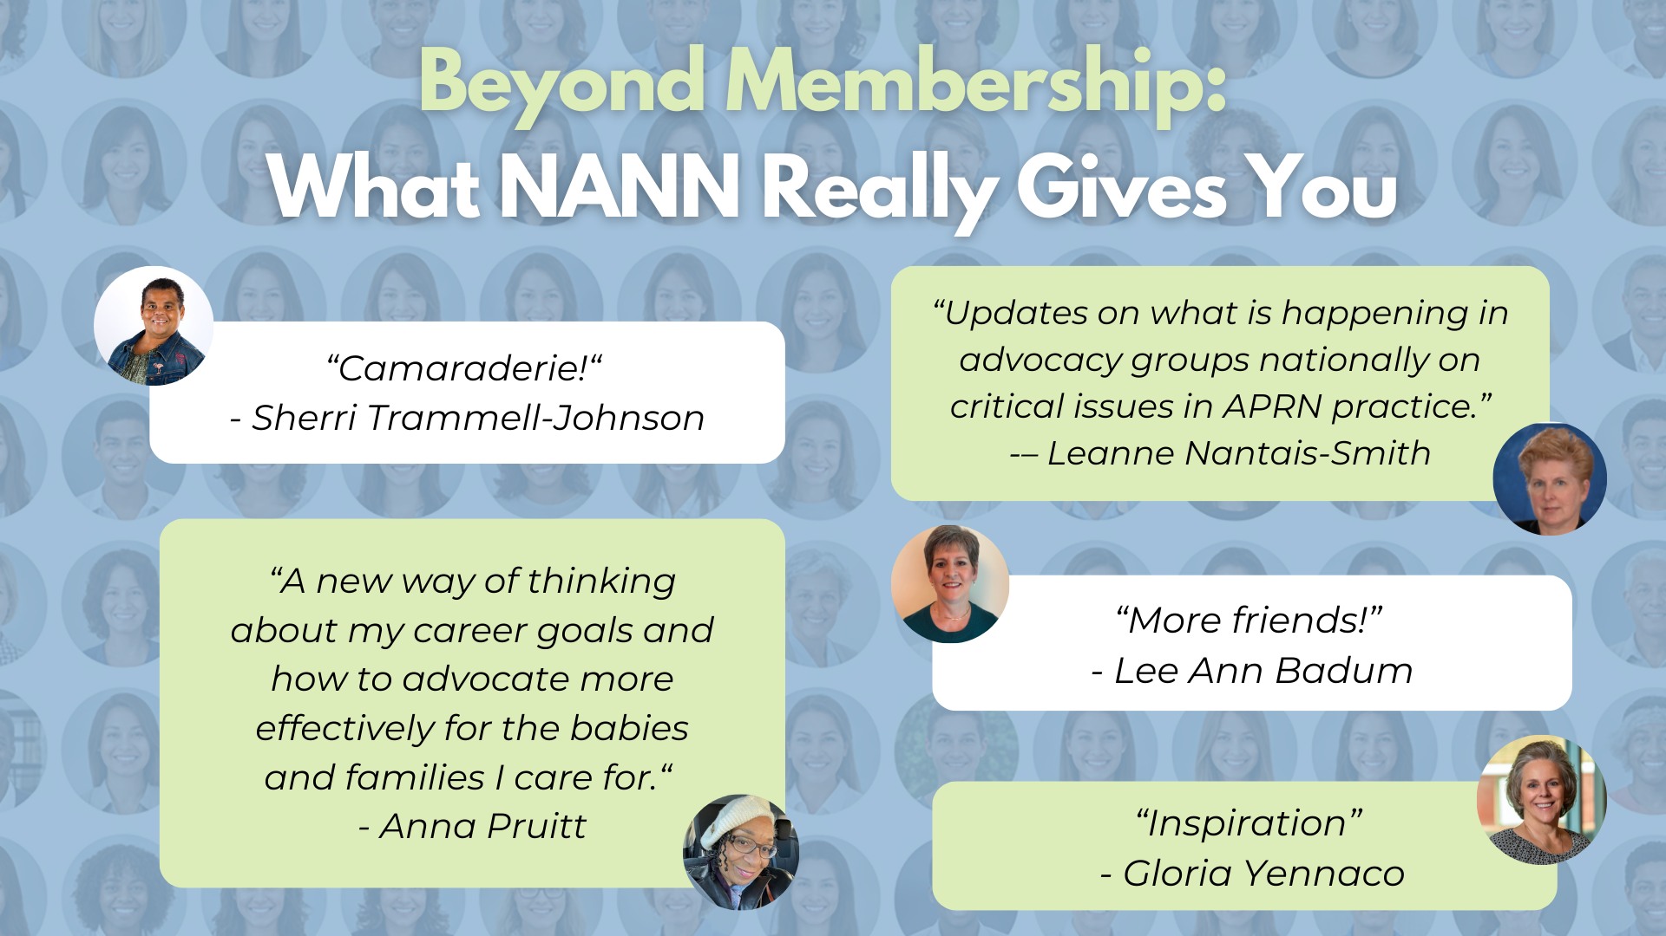
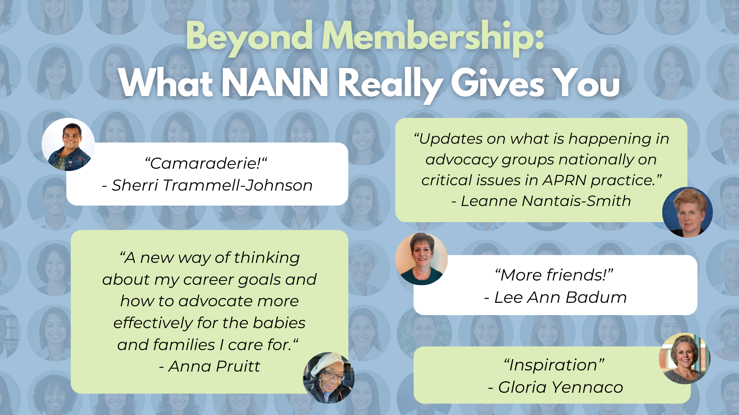
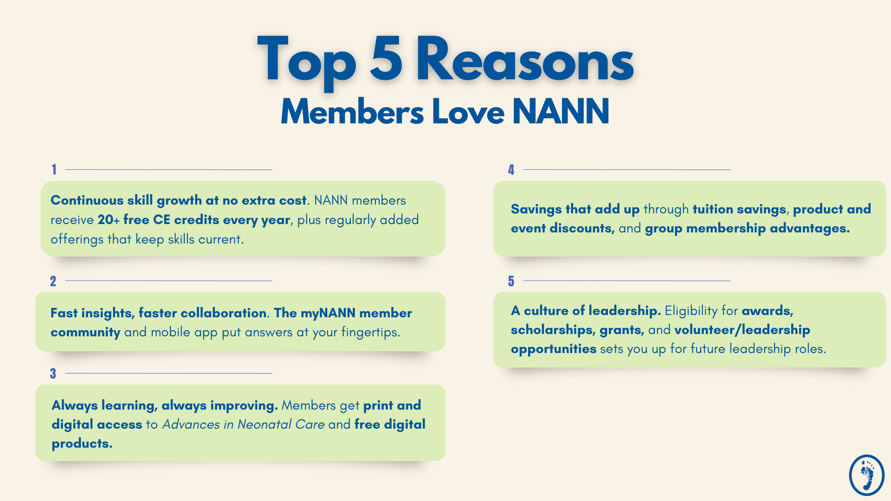
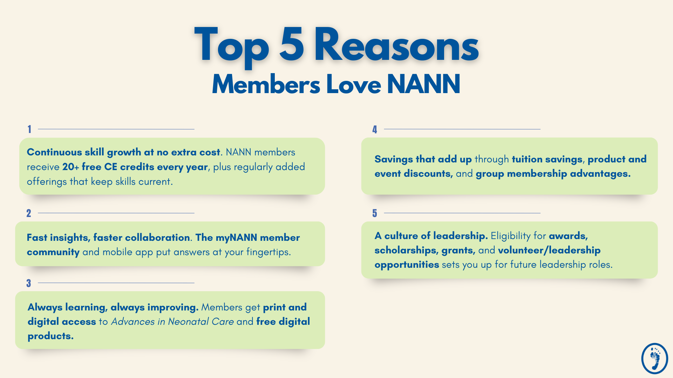
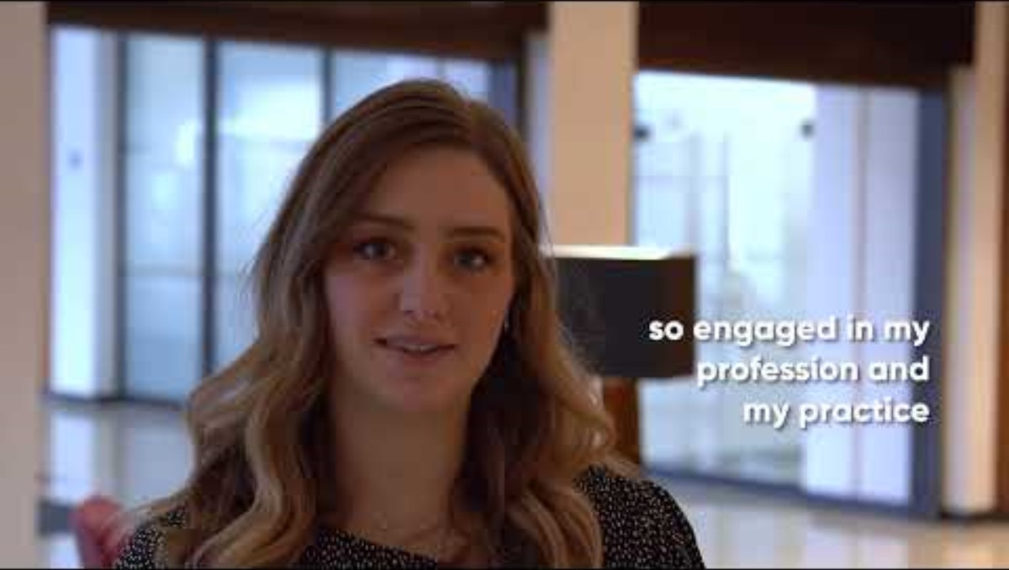
Notes:
When people talk about NANN, they’re really talking about a large network of neonatal nurses dealing with similar challenges across different hospitals and units. The value comes from shared experience, shared learning, and knowing there’s a broader professional community behind you.

Slide 8
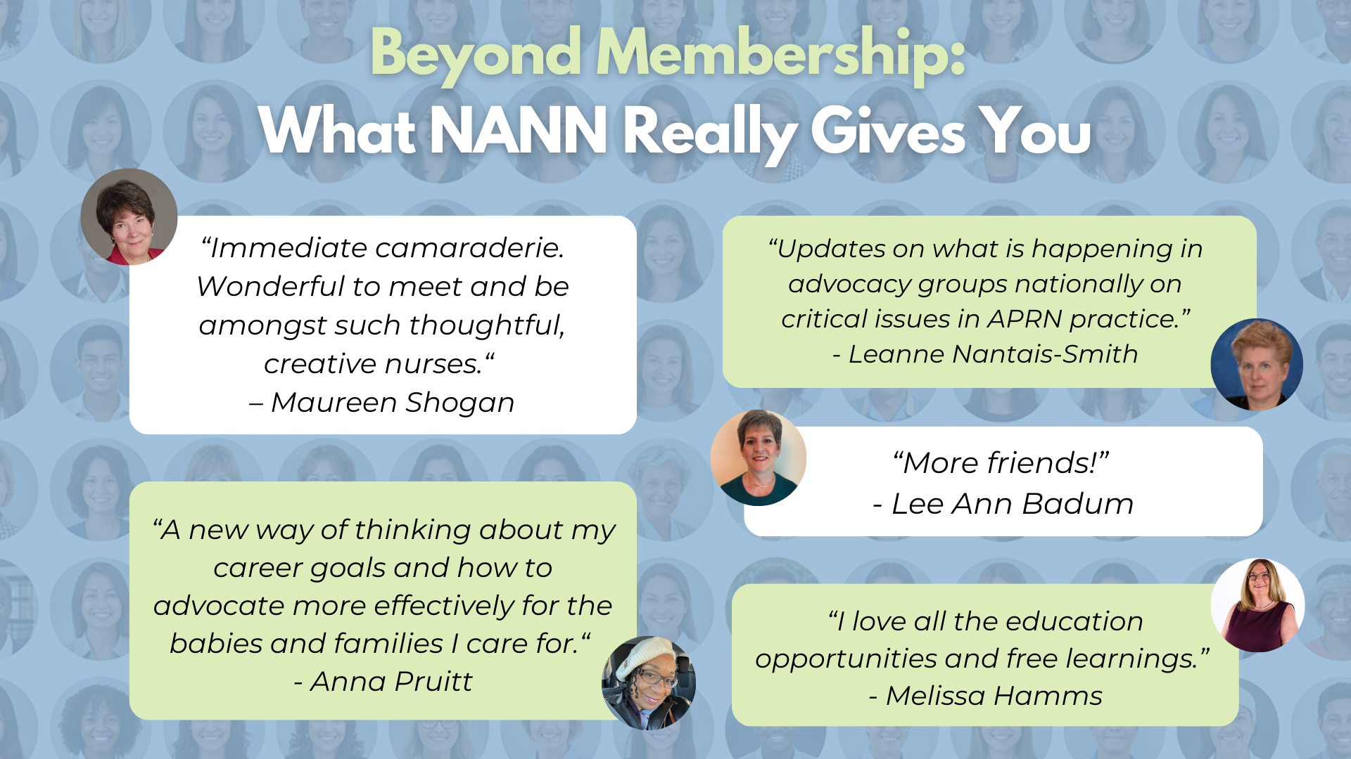
Notes:
Another important piece is that this community includes nurses at all stages and from a wide range of backgrounds. Whether you’re still getting comfortable in the NICU or starting to think about what comes next in your career, NANN gives you those opportunities to connect.

Slide 9
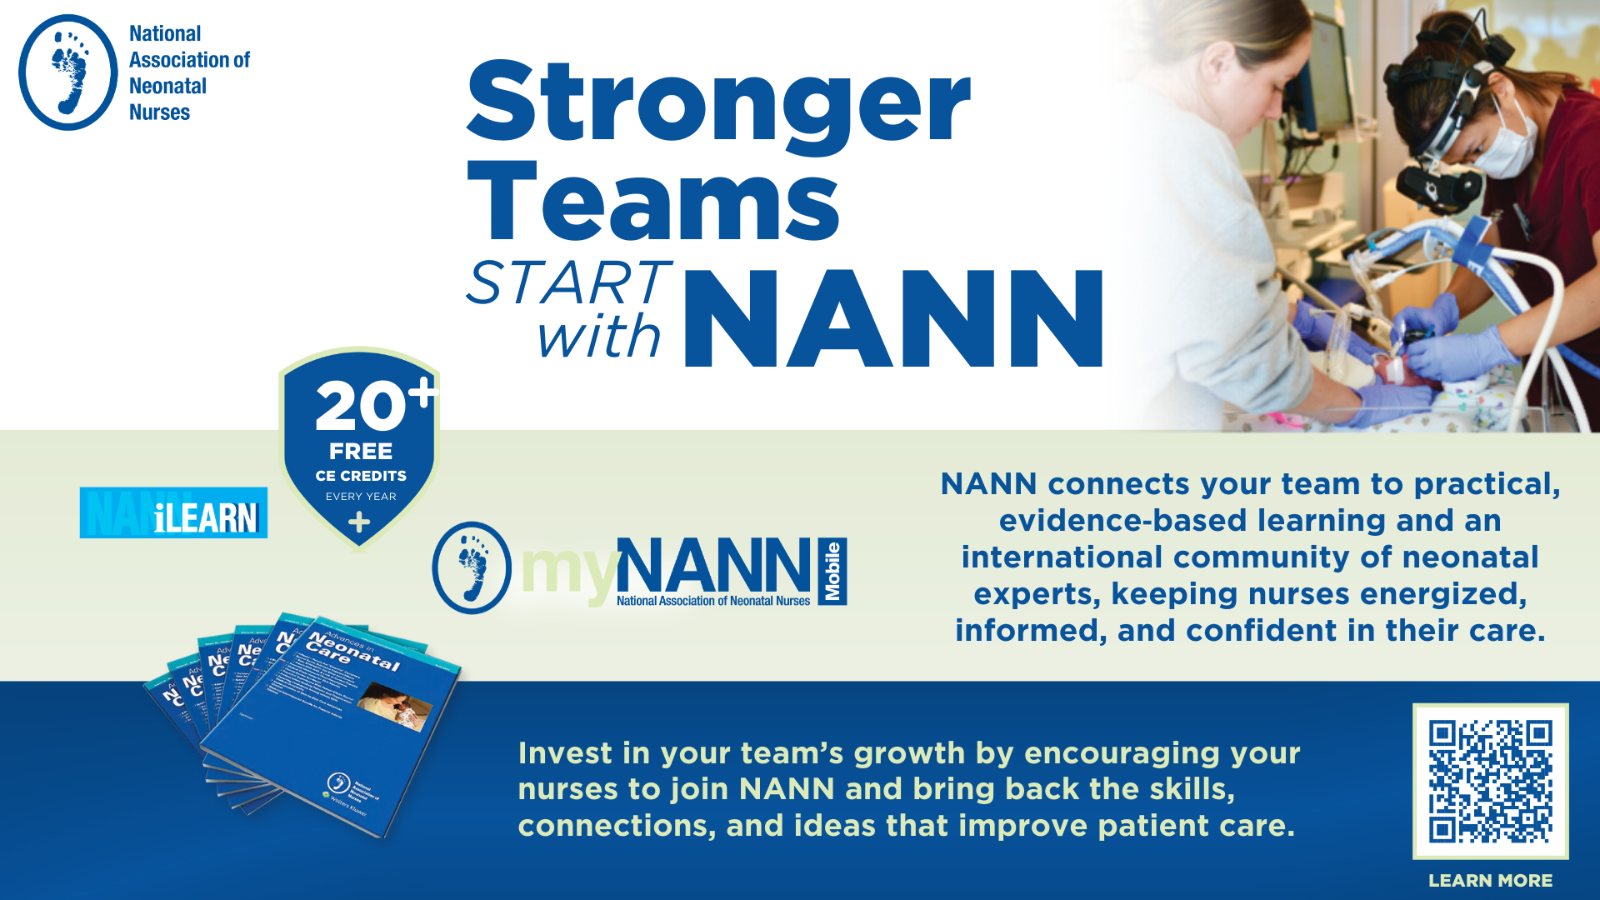
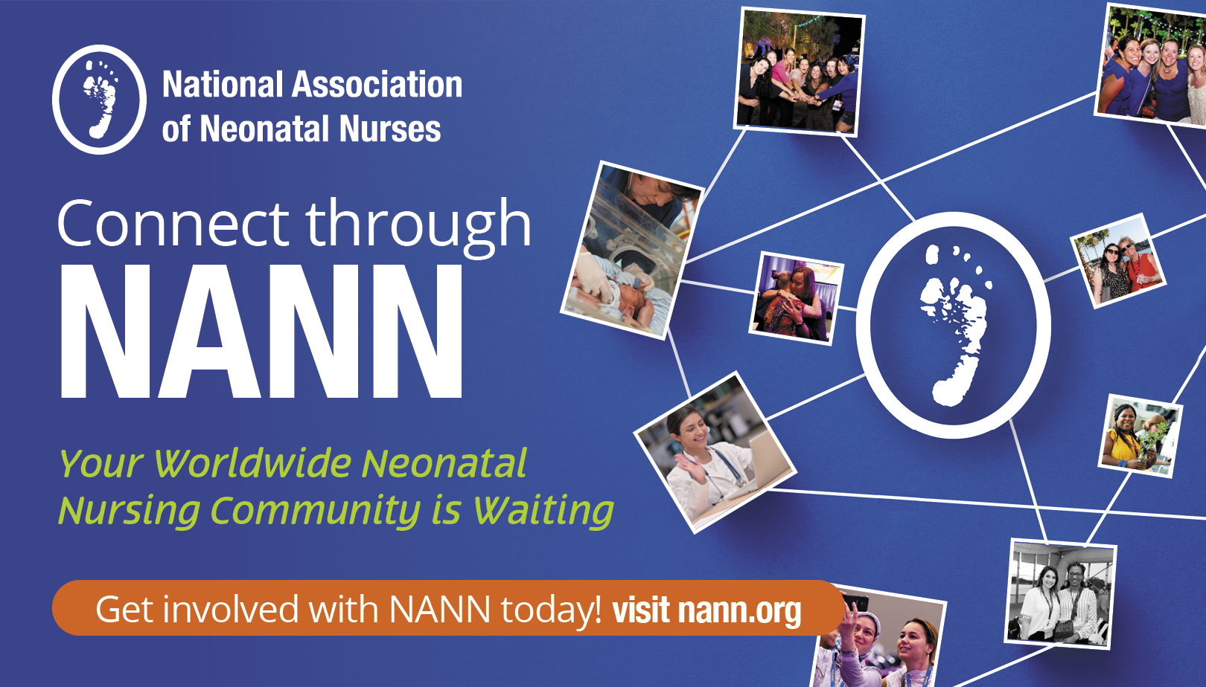
Notes:
What nurses need changes over time. Early on, the focus might be learning and confidence. Later, it may be certification, leadership, or advocacy. One reason people stay connected to professional organizations is that they can grow with you rather than being useful only at one stage.

Slide 10
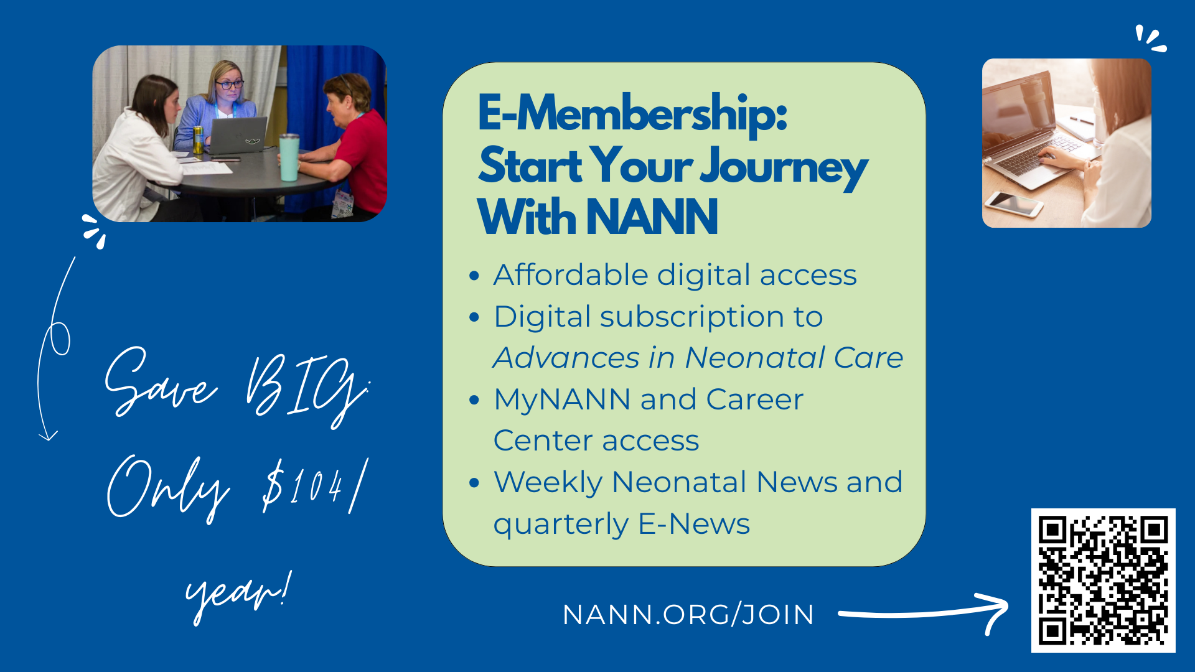
Notes:
E‑membership is a digital‑first option, so it works well if you’re early in your career, testing the waters, or just want something that fits easily into a busy schedule. It still gives you access to community updates, career resources, and professional connection at a lower price point.

Slide 11
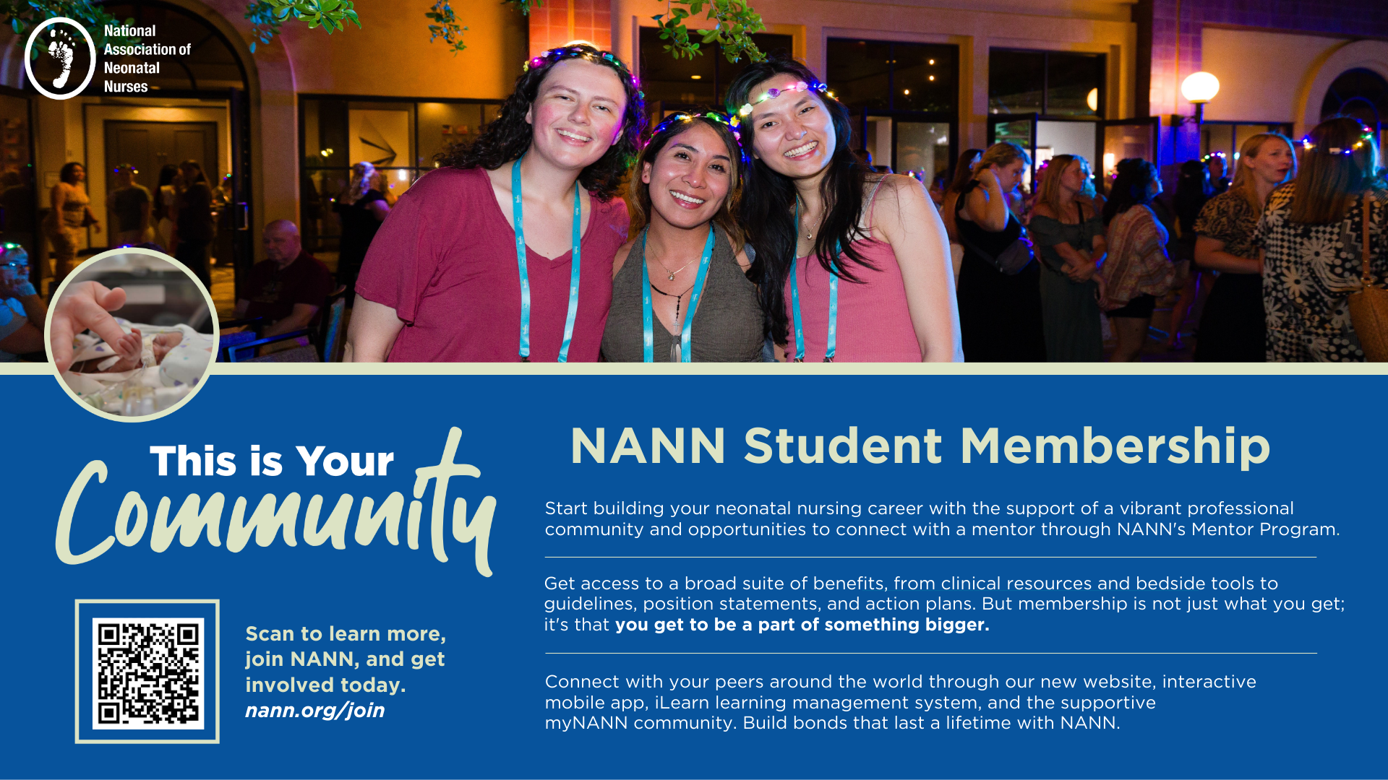
Notes:
Student membership is designed for nursing students who haven’t taken the NCLEX yet and want early exposure to neonatal nursing as a specialty. It gives students access to education, professional resources, and a sense of the neonatal nursing community before they’re fully in practice. For students or new grads interested in the NICU, this can be a helpful way to start building knowledge, confidence, and professional identity early, making the transition into neonatal nursing feel less overwhelming.

Slide 12
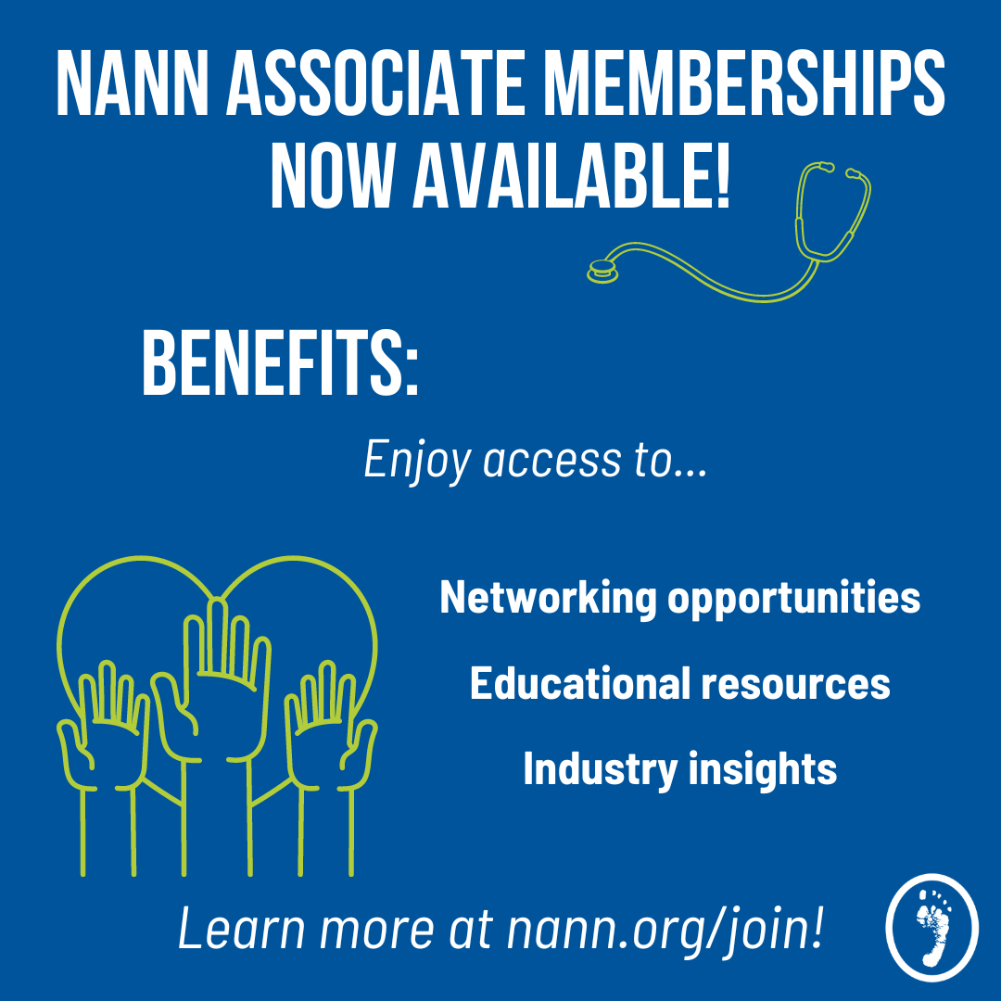
Associate Memberships Available!
Associate Memberships are tailored specifically for non-nurse healthcare professionals who care for neonatal patients and their families.
Let your NICU team know all are welcome to join NANN!
Notes:
Neonatal care is a team effort, and many of the people who influence outcomes for babies and families aren’t nurses. Associate membership exists so non‑nurse professionals who work in neonatal care can access neonatal‑specific education, resources, and professional connection. When nurses and other care team members are learning from the same evidence base and engaging with the same professional community, it strengthens collaboration and consistency in practice.

Slide 13
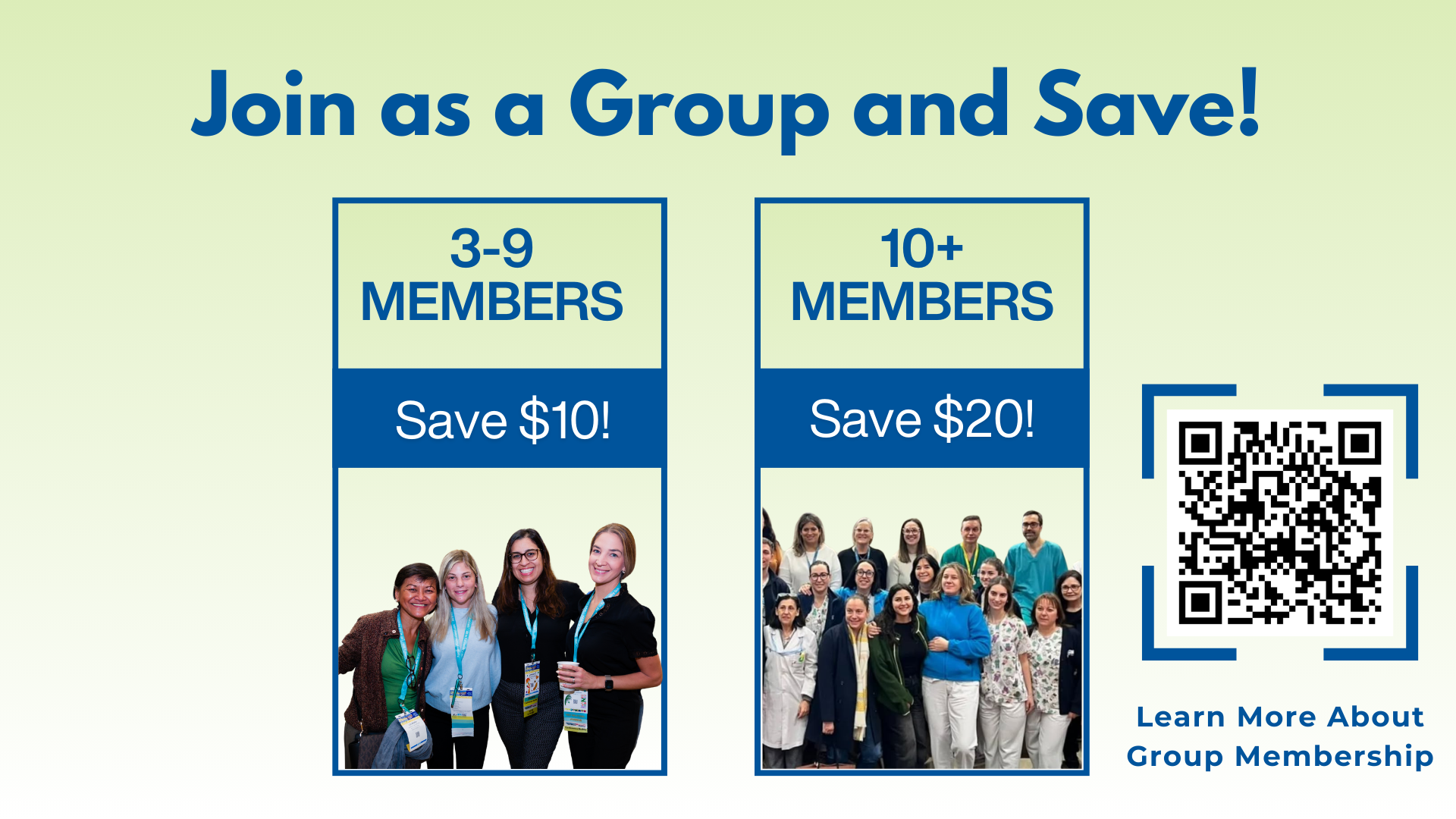
Notes:
When multiple people from the same unit join together, the value becomes more immediate and more practical. You’re learning the same concepts, hearing about the same resources, and able to talk through how things apply to your own unit. Plus, you’ll save up to $20 per person!

Slide 14

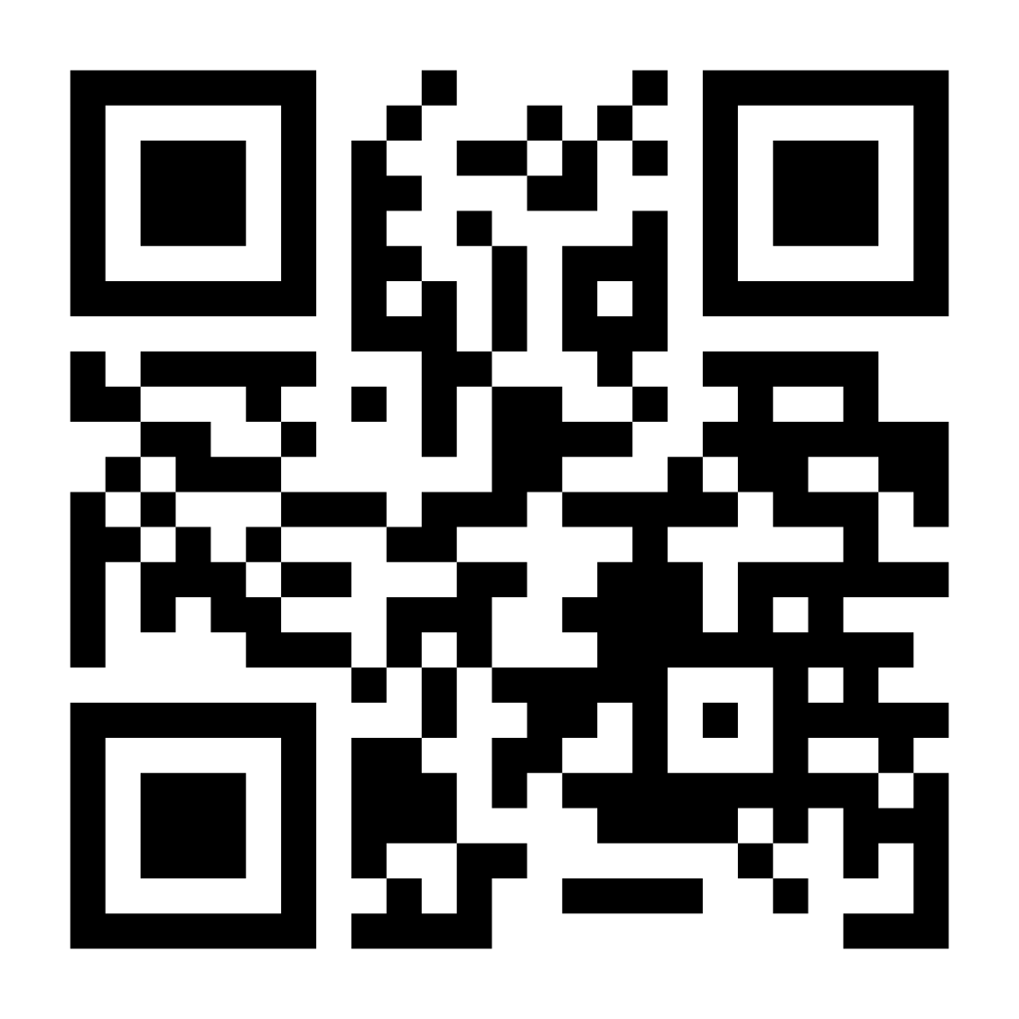

NANN PPT Title
Day, Month, Date, Year
Time
Register at nann.org/conference with Best Value pricing
through June 16, 2026!
Notes:
Conferences are one of the main ways neonatal nurses stay up to date on evidence, hear from experts in the field, and connect with nurses from other NICUs. They also help put everyday practice into a bigger professional context. NANN members save $135 on conference, which means membership practically pays for itself.

Slide 15
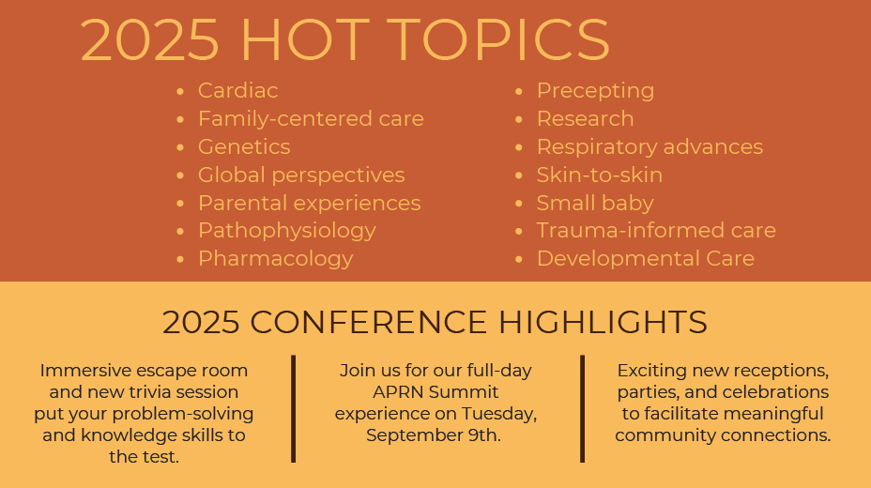


Notes:
Nurses come back from conference each year with practical ideas they can bring back to their unit. And beyond education, conferences are a chance to step out of the day‑to‑day routine, talk with other neonatal nurses, and see how different units approach similar challenges.

Slide 16
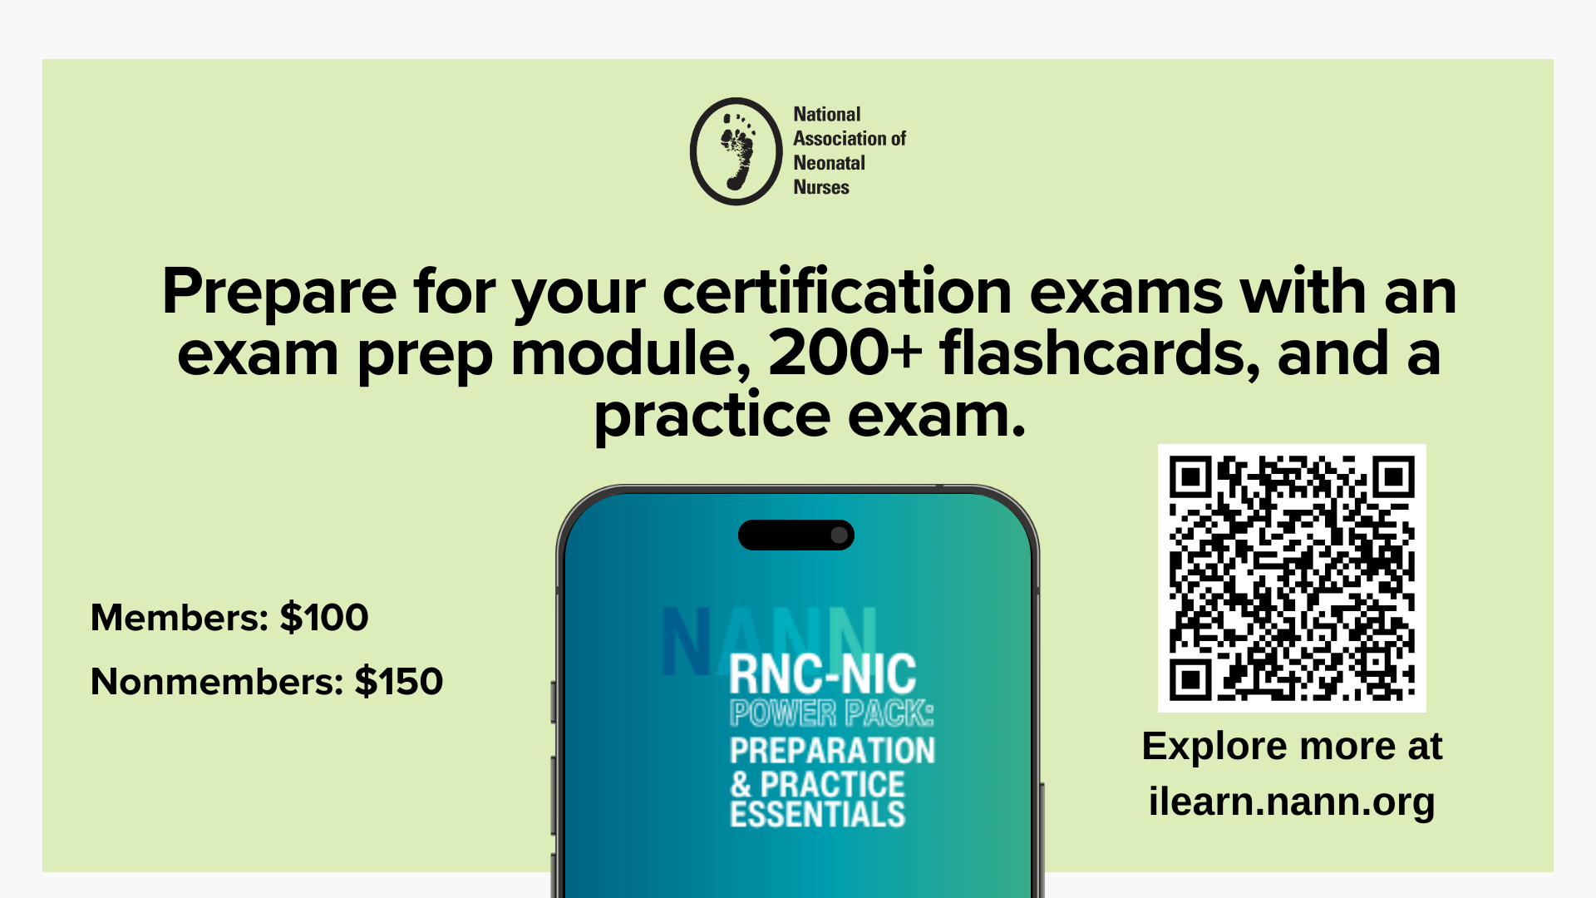

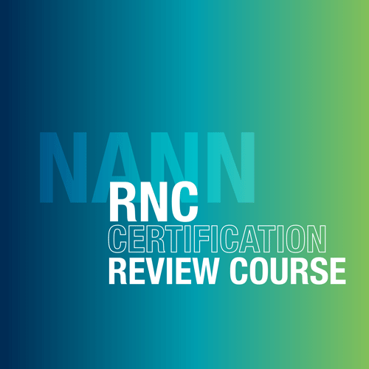
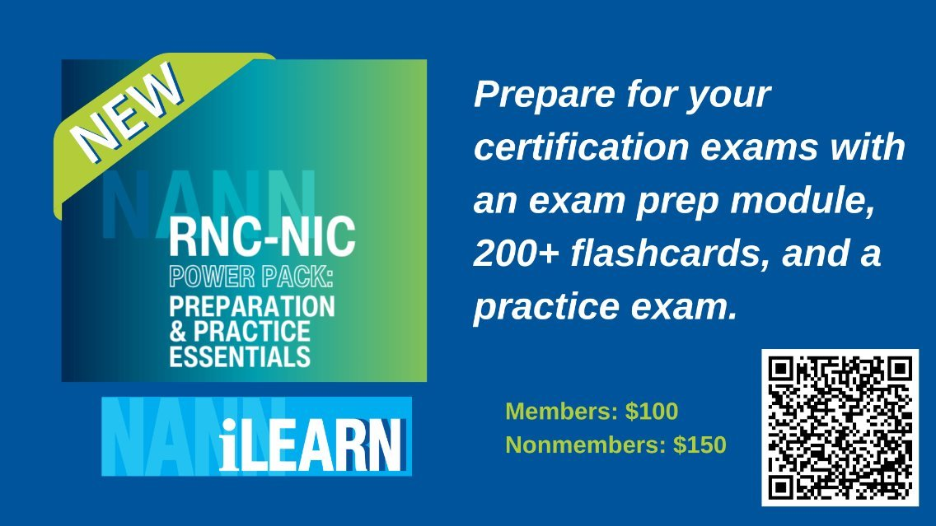
Exclusive Institutional Offer:
Access the RNC Review Course
at member base prices!
Empower your neonatal nurses for NCC and CCRN exam success
Tailored for institutional use with personalized learning
The larger your unit, the more you save!
Notes:
The RNC‑NIC Power Pack is a focused certification preparation resource designed for nurses who are planning to sit for the RNC‑NIC exam. It gives you the tools to study smarter, including an exam prep module, 200+ flashcards, and a practice exam. Plus, you’ll earn 6.5 CE credits along the way!

Slide 17
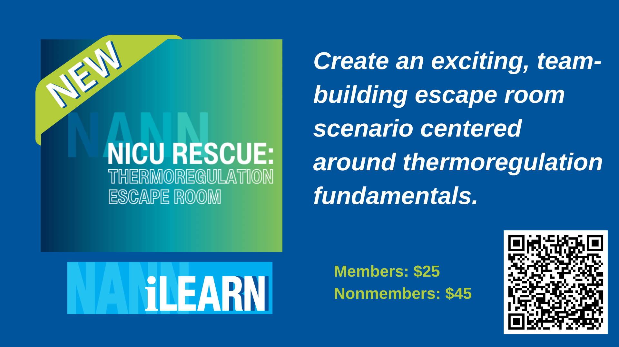
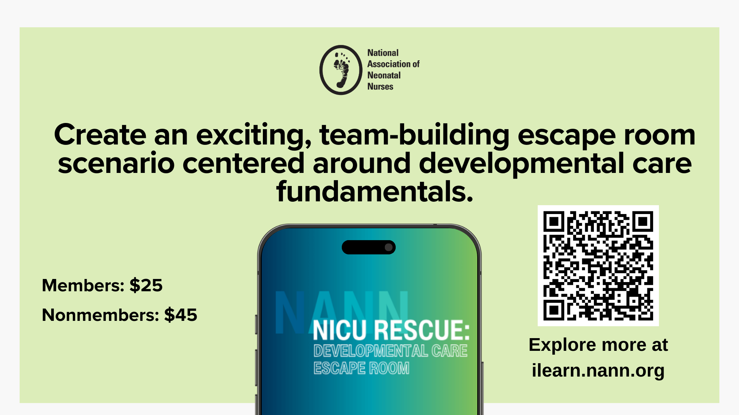
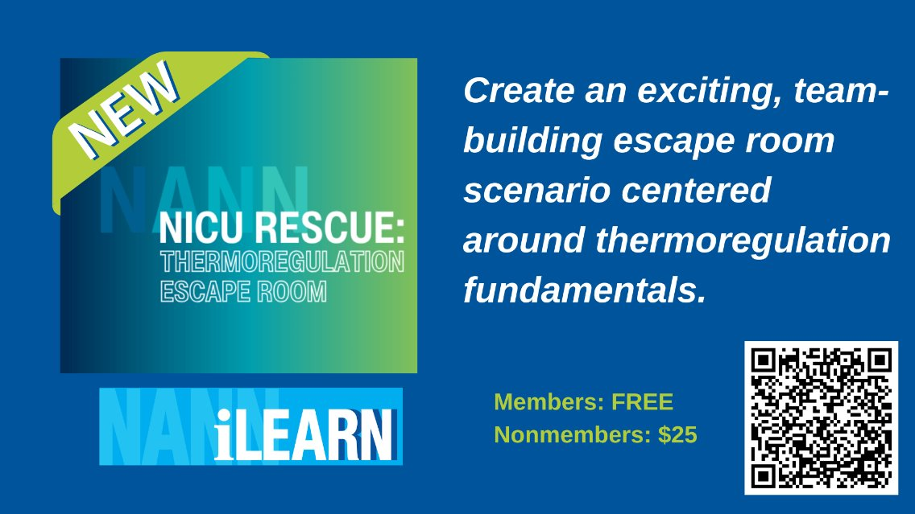
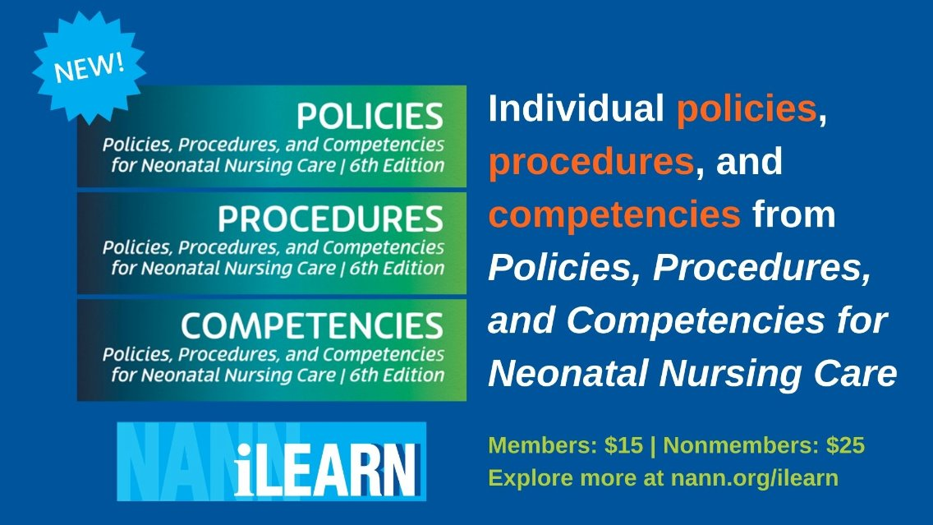
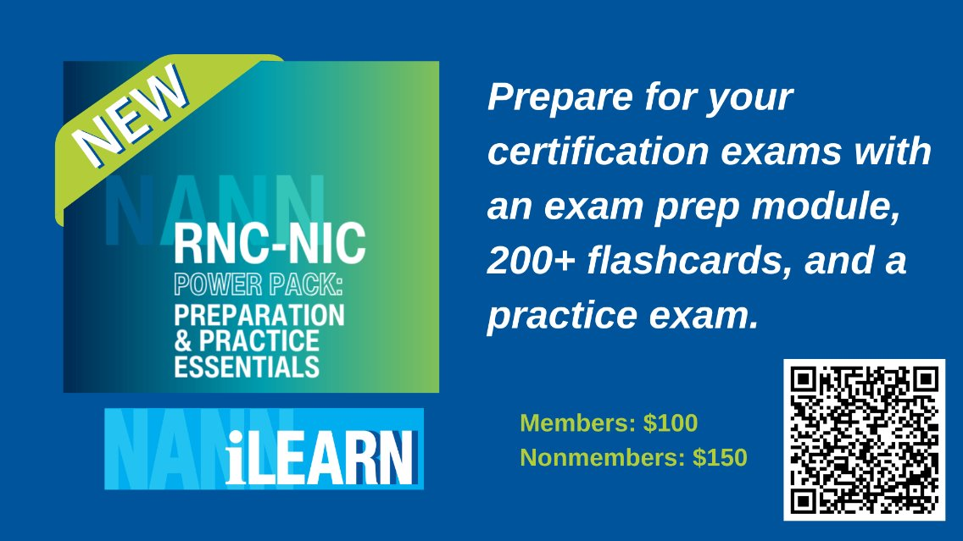

Find, connect, and develop mentoring relationships with fellow NANN members. We know that strong mentor partnerships not only strengthen the NANN community but are a tremendous tool for our members' professional development. Please note: the mentor program focuses on mentor partnerships that help participants achieve a wide range of career-related goals but is not intended to assist with a job search.
Notes:
Turn developmental care fundamentals into an unforgettable experience with the Developmental Care Escape Room Toolkit! This music-festival-themed toolkit helps you create a fun, team-building escape room that validates knowledge and sparks collaboration. With moderators guiding participants through timed challenges, your team will learn while having a blast.

Slide 18
Notes:
Developmental care is the foundation of neonatal practice. Now, the updated Neonatal Developmental Care Specialist Designation gives you a clear way to validate that expertise and strengthen your credentials.
The exam is self-paced and online, so you can complete it on your schedule. It includes 100 questions—a mix of cognitive and scenario-based items—aligned to the Developmental Care of Newborns & Infants, 3rd Edition. Once you pass with a score of 80% or higher, you’ll earn recognition that lasts for three years, with renewal options that fit your professional development plan.

Slide 19
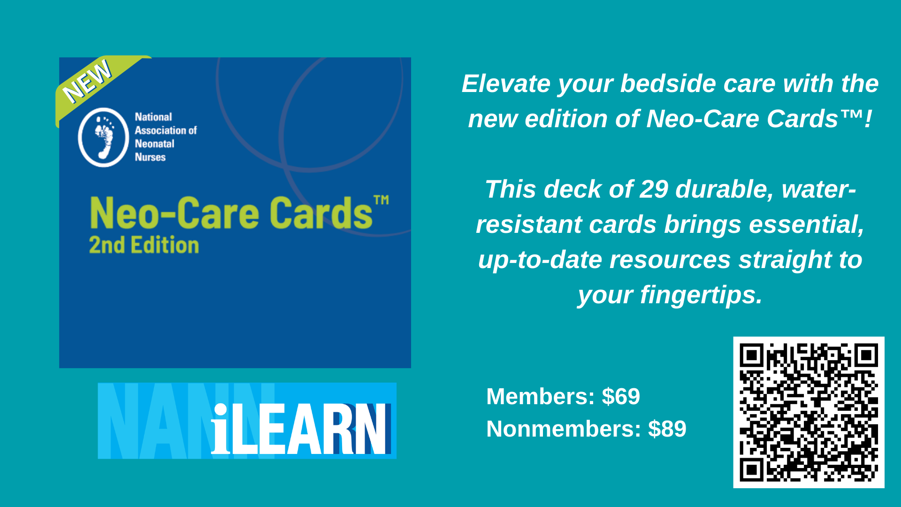
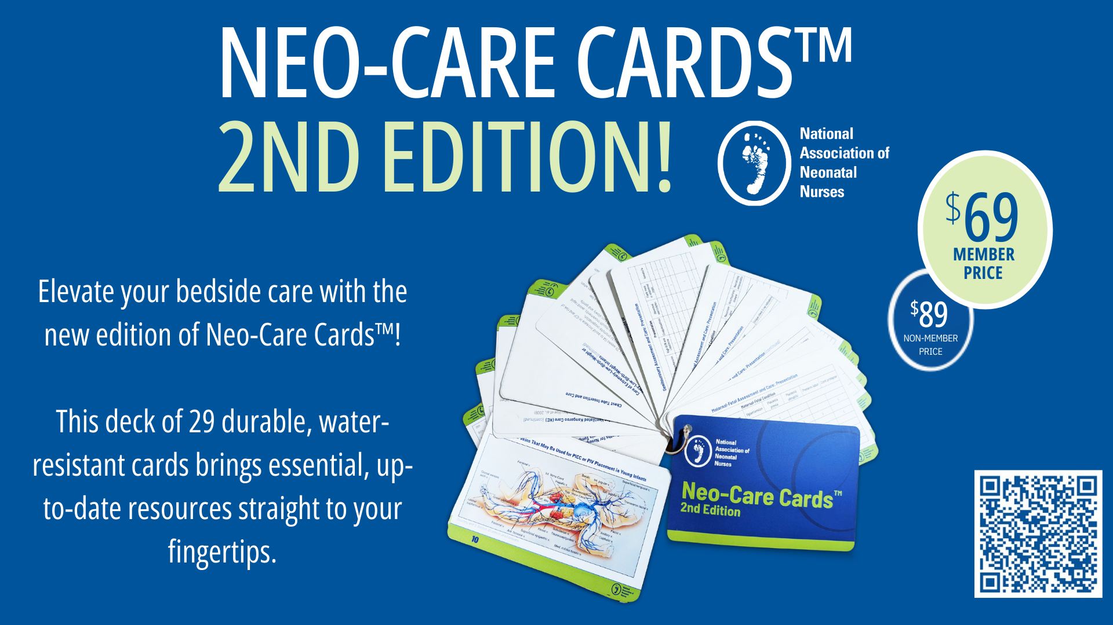
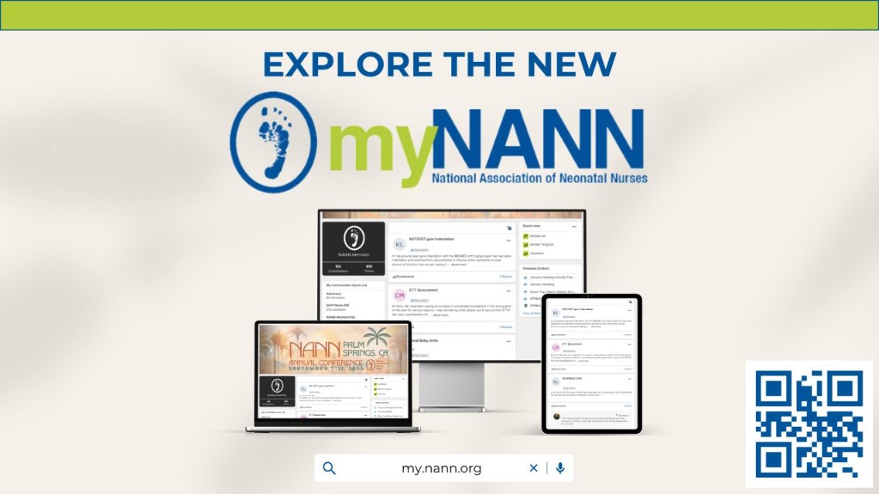
Find, connect, and develop mentoring relationships with fellow NANN members. We know that strong mentor partnerships not only strengthen the NANN community but are a tremendous tool for our members' professional development. Please note: the mentor program focuses on mentor partnerships that help participants achieve a wide range of career-related goals but is not intended to assist with a job search.
Notes:
The new Neo-Care Cards™ provide valuable information for bedside care in a concise, accessible format.
This edition is filled with exclusive, essential information, ensuring you have the most up-to-date and comprehensive resources at your fingertips. Plus, these vinyl cards are connected with a small metal ring to make them easy to carry, access, and clean.

Slide 20

2025 ADVOCACY ACCOMPLISHMENTS
Established partnerships with external organizations recognized in neonatal health policy
  Increased the visibility of the Health, Policy, and Advocacy Committee (HPAC) advocacy agenda
  Signed on to a variety of important bills and letters through the Nursing Coalition Community and other collaborative partnerships
  NANNcast advocacy annual topics and series planned in 2025
  Working with AWHONN on collaborative Hill Day 2026
Notes:
Through partnerships, coalitions, and policy engagement, NANN represents neonatal nursing perspectives at a national level. Membership supports this collective voice and helps ensure neonatal care issues are part of broader healthcare conversations.

Slide 21
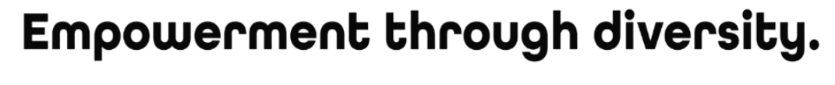
DIVERSITY, EQUITY & INCLUSION
ONE NANN:
A diverse workforce and an inclusive environment are essential for NANN to deliver a high level of equitable care serving ALL patients and families across ALL communities
Created ONE NANN Committee to guide NANN’s strategic DEI efforts
Promote the importance of health equity and workforce diversity through advocacy, research, policy statements, education, and community building
Partnered with March of Dimes for NANN leader implicit bias training
Launched e-membership in 2023 and associate membership of non-nurse healthcare professionals in March 2024
Launched name change of advanced practice division to be more inclusive in March 2024
Considering recent Executive Orders impact on DEI and grant funding, the committee is setting new goals for the current year
Notes:
ONE NANN ensures the profession reflects the people it serves and supports nurses across roles, backgrounds, and career stages. This includes work around education, advocacy, research, and inclusive professional structures.

Slide 22
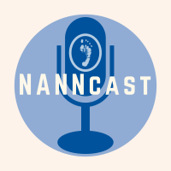
NANN’s PODCAST: NANNcast
Advice and expertise for nurses, families, multidisciplinary and industry partners on a wealth of clinical, professional development, and advocacy topics.
Over 140K downloads:
Navigating the Challenges in Maternal and Neonatal Health
Mandatory Reporting in the NICU
Q-Rounds
Navigating Pain and Stress
Nursing Innovation in the NICU
APRN Scope of Practice Position Statement
Stream your favorite topics today!
Notes:
NANNcast, NANN’s podcast, is a flexible learning option that covers clinical, professional, and advocacy topics. For nurses with busy schedules, this is an easy way to stay engaged with current issues and ideas without needing dedicated study time.

Slide 23
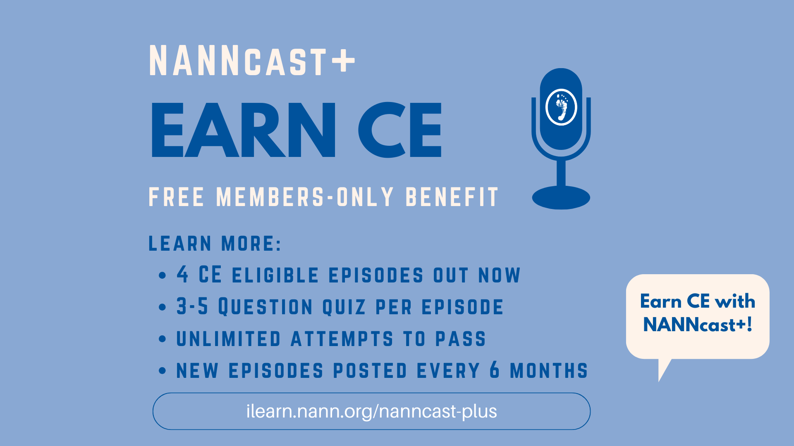
Notes:
NANNcast+ is a member‑only benefit that allows you to earn CE by listening to selected NANNcast podcast episodes and taking a short quiz. The episodes available for CE rotate every few months, offering a convenient option for ongoing education.

Slide 24
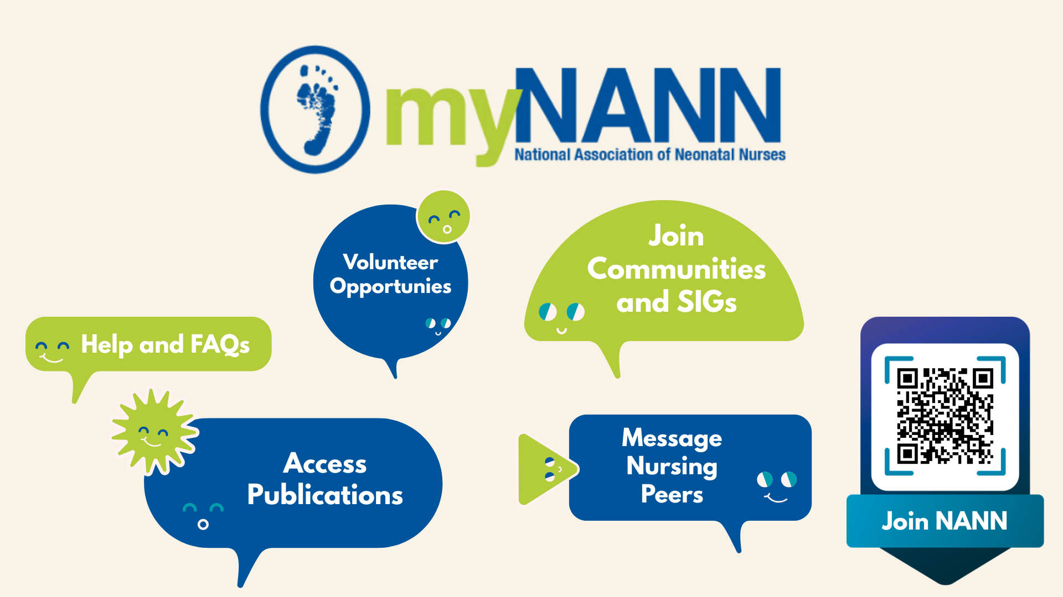
Notes:
MyNANN is where NANN members get answers fast. From the latest trends in neonatal care to upcoming events, members connect in a vibrant forum filled with community highlights, special interest groups, mentoring programs, and more. It’s available both online and through our mobile app.

Slide 25
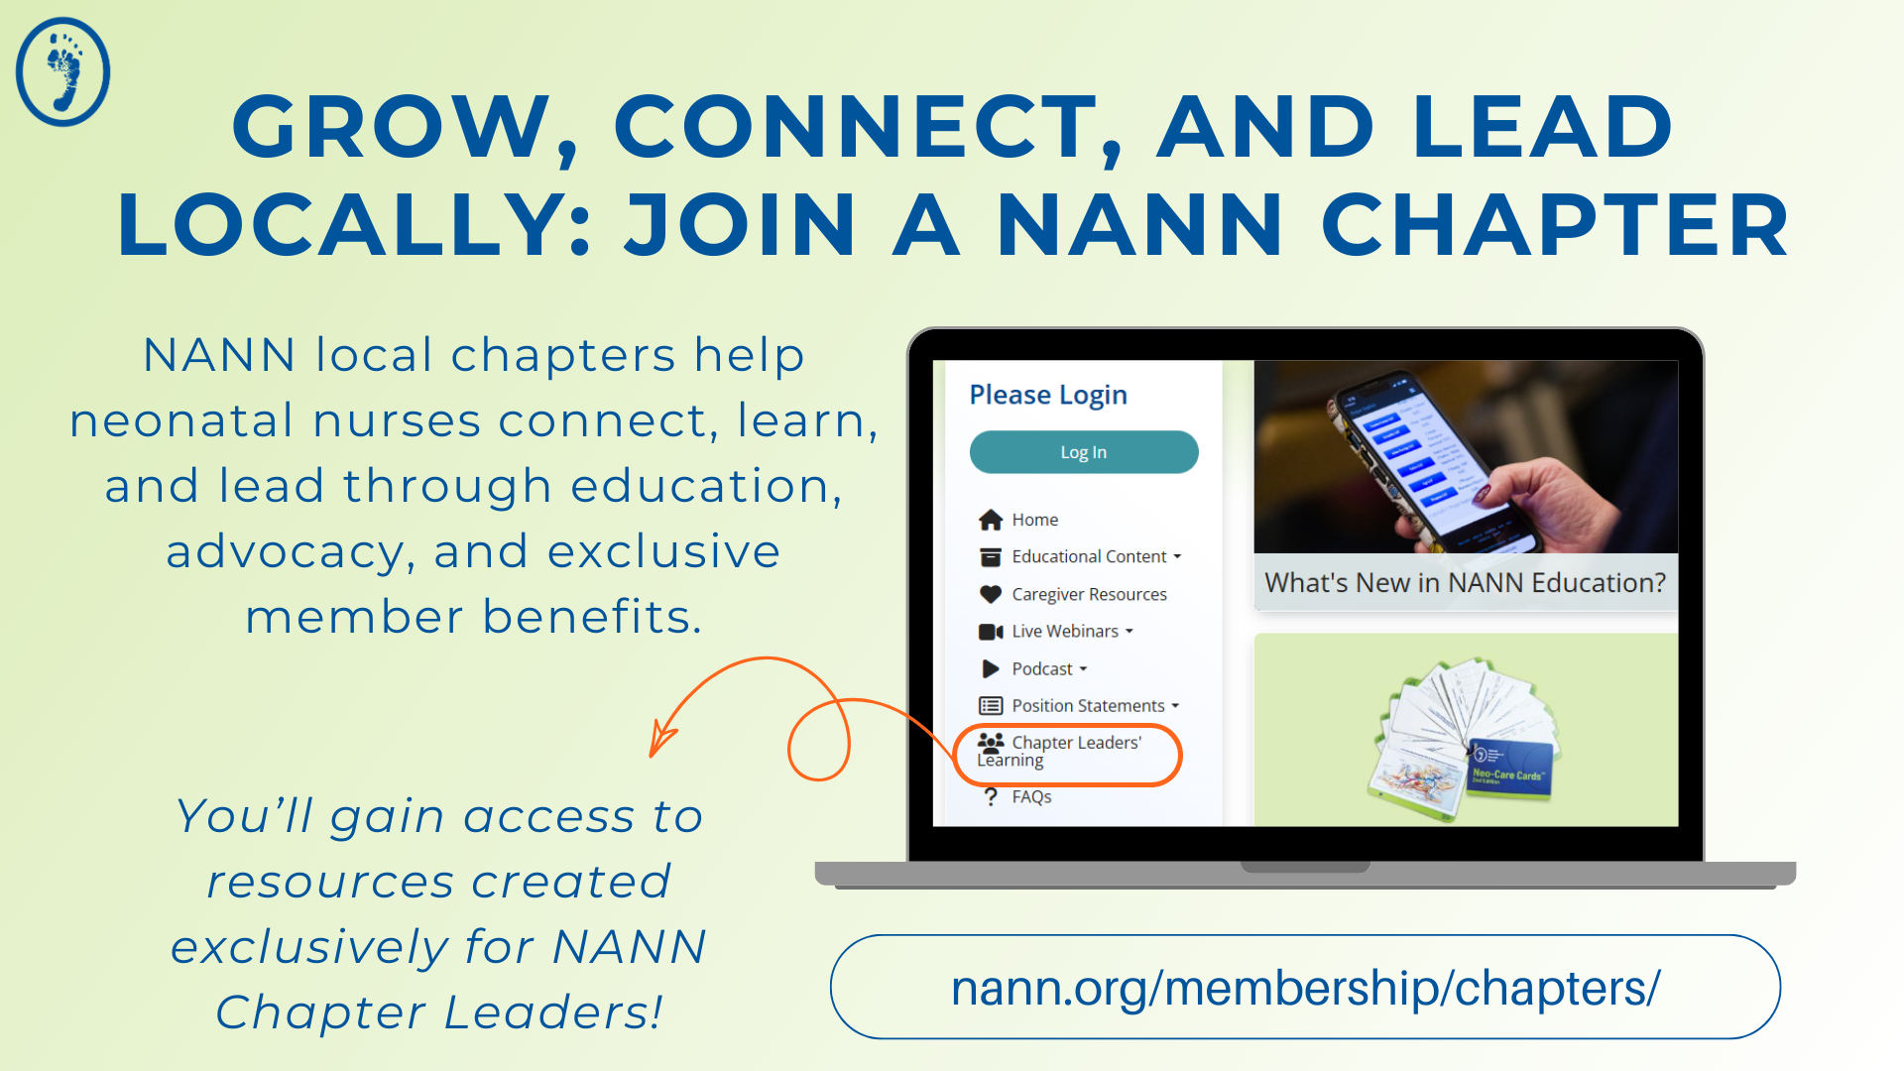
Notes:
Chapters are a way for nurses to connect at a more local or regional level, offering opportunities to participate in education, networking, and events that are often more accessible and easier to fit into busy schedules. Being part of a chapter helps build connections with nearby colleagues and strengthens professional engagement closer to home.

Slide 26
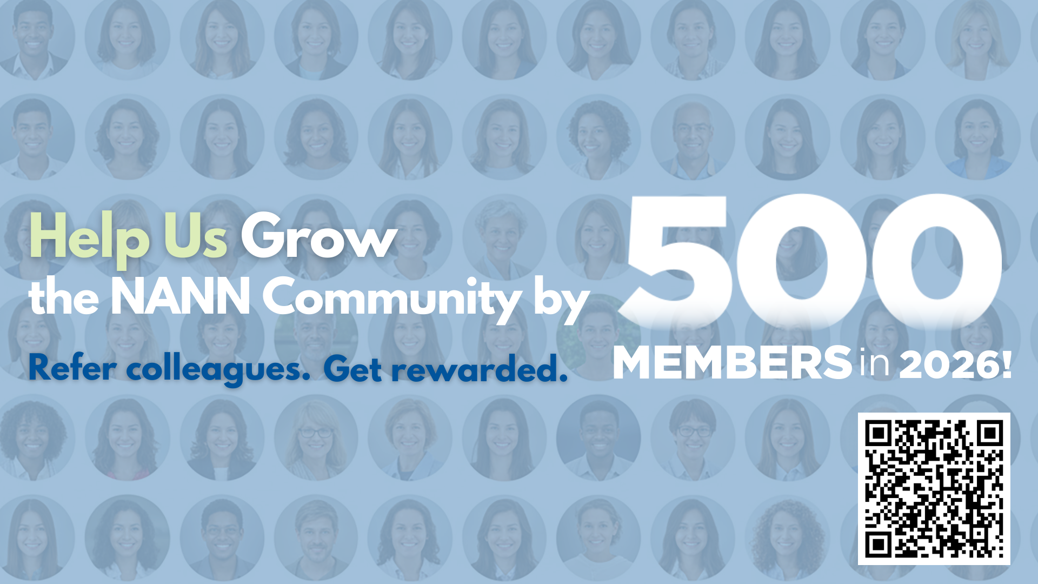
Notes:
NANN’s goal is to grow the community by 500 new members in 2026 and strengthen the neonatal nursing community by bringing more nurses into the same professional space. When more nurses are involved, there’s more shared learning, more perspective, and a stronger collective voice.

Slide 27

Notes:
You can help grow NANN by inviting a colleague or sharing in your unit. When you refer new members, you’ll earn badges in myNANN and unlock new referral rewards:
3 referrals: Entry into our quarterly membership raffle
4 referrals: Entry into our quarterly conference raffle
5 referrals: $100 off your membership renewal
10 referrals: $200 Amazon gift card

Slide 28
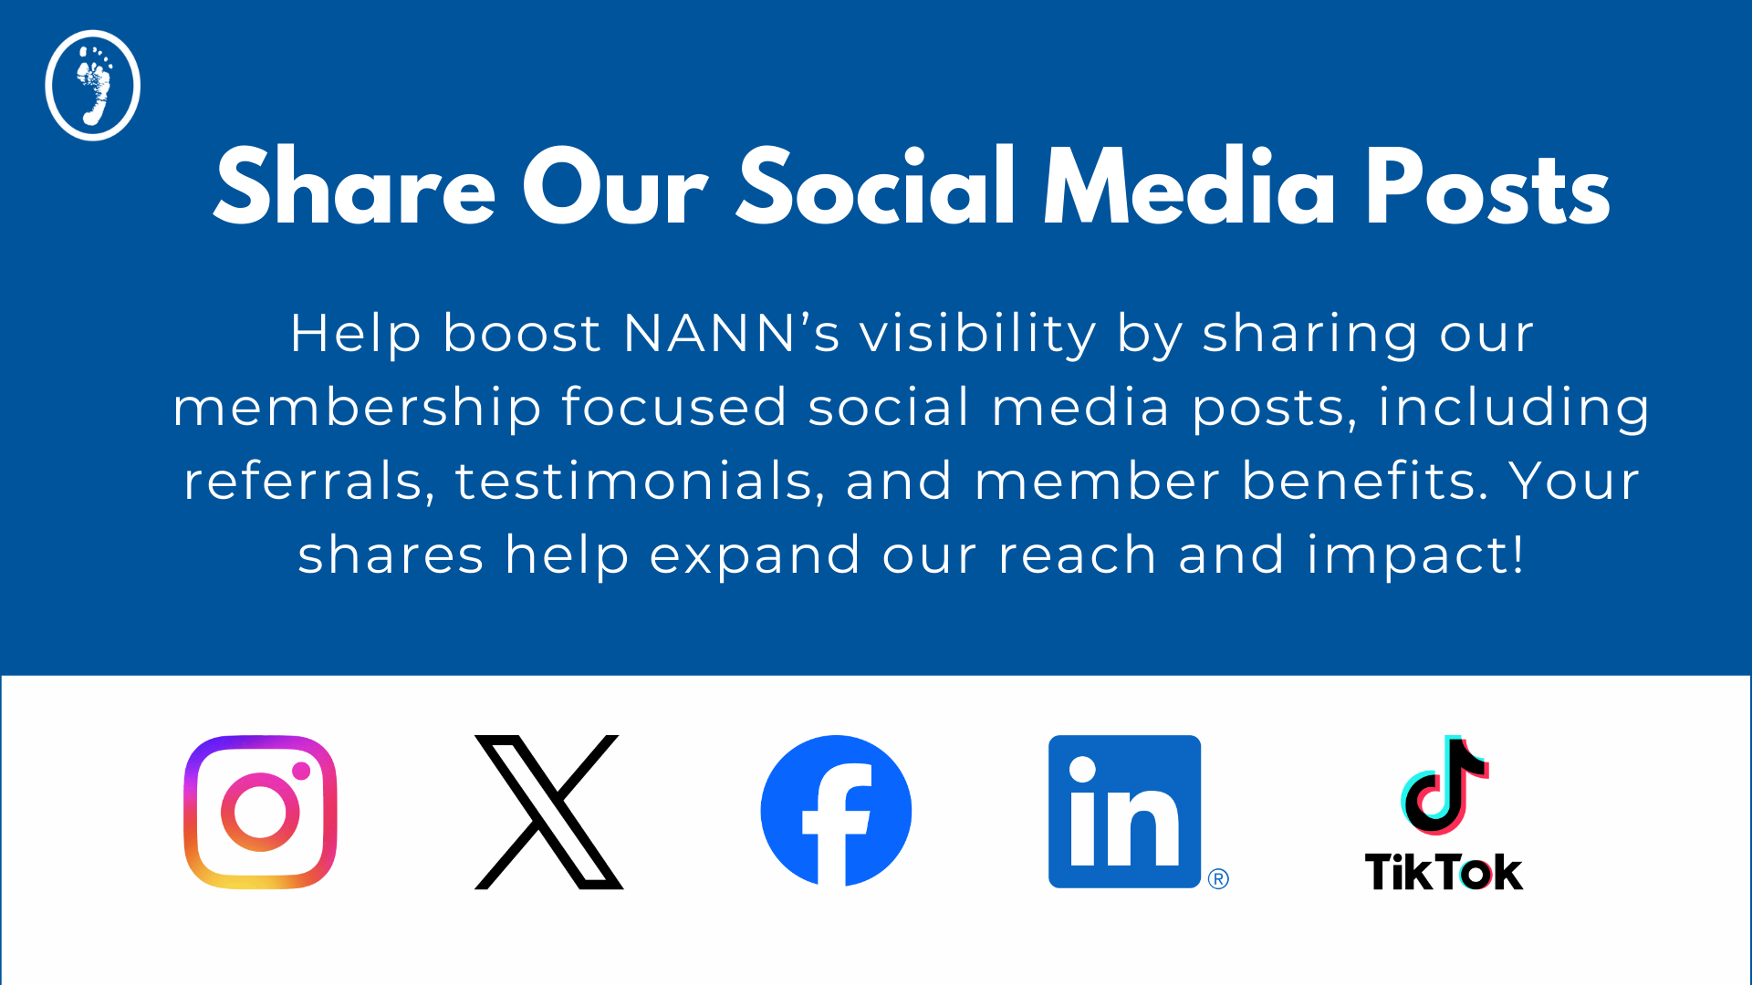
Notes:
An easy way to spread the word is by sharing NANN’s social media posts! Follow NANN on Instagram, X, Facebook, LinkedIn, and TikTok, and make sure to like, comment, and share.

Slide 29
MORE THAN EVER, NOW IS THE TIME TO JOIN NANN
Notes:
Neonatal nursing is demanding, and it keeps getting more complex. Evidence changes, expectations grow, and it can feel like there’s always more to know. One reason professional associations exist is to help nurses stay current and supported without having to figure everything out on their own. For early‑career nurses especially, this kind of structure and support can make a big difference.

Slide 30
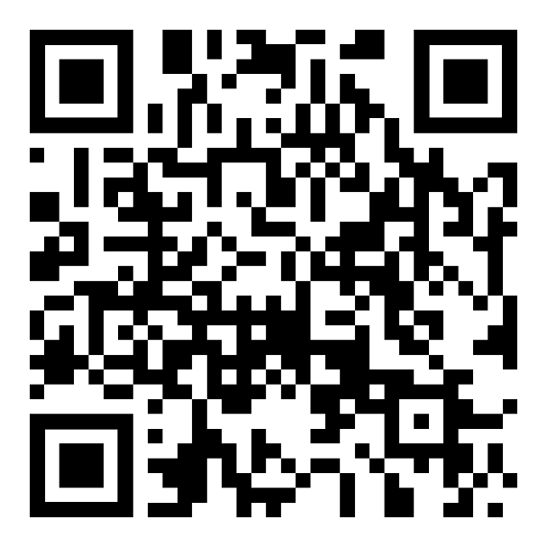
READY TO FIND YOUR PROFESSIONAL HOME?
JOIN NANN TODAY!
Notes:
Staying current, supported, and connected is part of providing the best care! Join the NANN community today by scanning the QR code.

